Slide 1

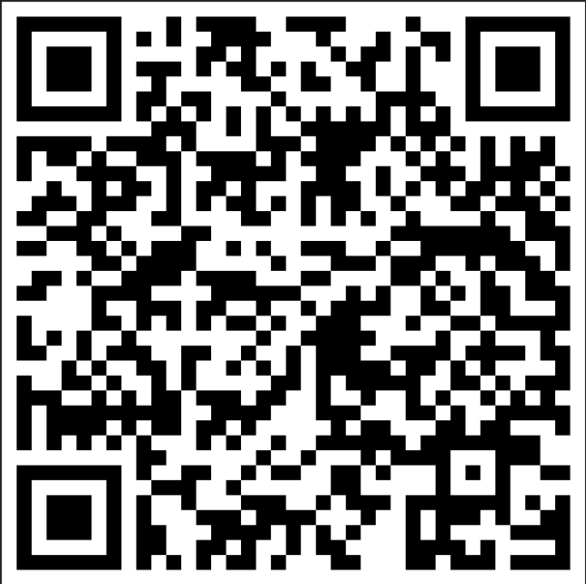

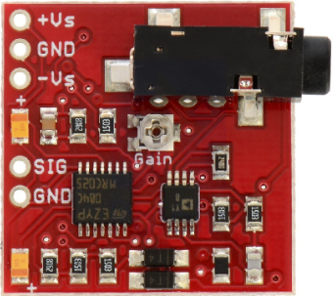
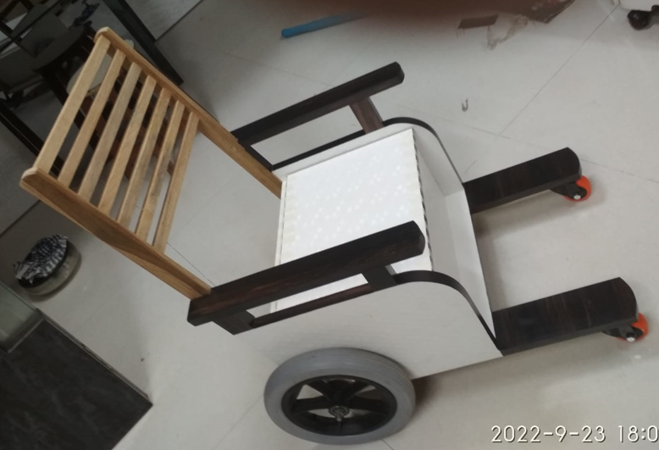
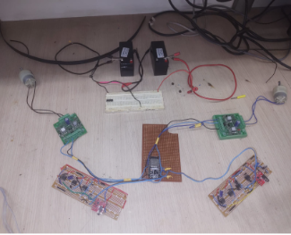
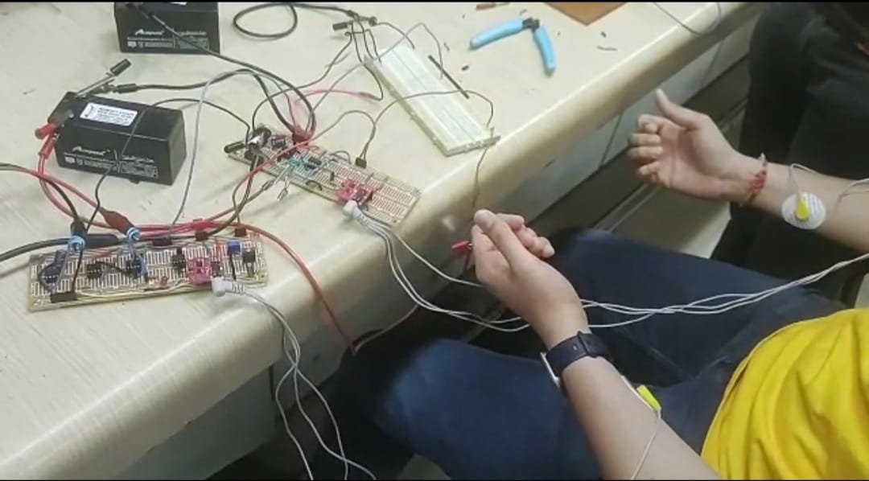
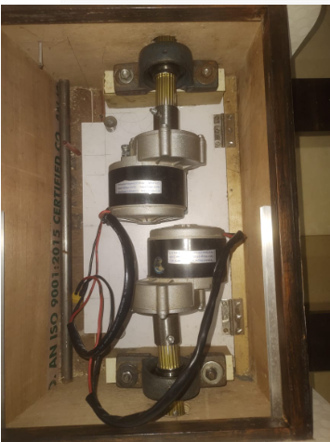
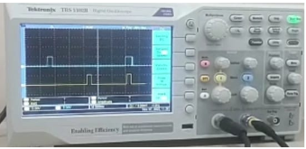
contact mail id:
neelkaria.enkay@gmail.com
Now Live @
EMG controlled wheelchair
Neel Karia Rohit Joshi Aryan Desai Yash Khanolkar Cherry Bhatt
60001190033 60001190045 60001190007 60001190060 60001190010
Guided by: Prof. Vivek Nar
Introduction
Physically challenged people face constraints in day to day movements.
In the current scenario, joystick based wheelchairs are operated by the users which cannot be used by those whose upper limb movements are constrained or are paralyzed.
Hence, to overcome such severe problems, we aim to develop an EMG (Electromyography) signal controlled wheelchair.
Electromyography is a technique which measures a particular muscle’s response / movement and converts it to electrical pulses.
Features
The wheelchair is implemented with electrodes and muscle sensors which sense the twitching of the muscles.
It is also equipped with IOT features like live location tracking and user dashboard for wheelchair monitoring on the cloud.
The wheelchair will be in a permanent state of braking unless explicitly initiated by the user.
Method
Literature Survey was performed regarding Electromyography and to ascertain our approach regarding control electronics.
Simulation was implemented to check the workability of different modules.
All these modules were integrated to check the circuit physically on the breadboard.
This was replicated on the general purpose board and tested successfully.
Simultaneously, a logical code and custom made wheelchair were being developed.
The motors and drivers were tested with the electronics and then incorporated into the wheelchair.
The EMG Controlled wheelchair was successfully checked with all its components for it’s workability.
Building Blocks
Figure 1. EMG Muscle Sensor v3.0 module
Figure 2. Setup for prototype testing with dummy motors
Figure 3. Motor housed inside the wheelchair
Figure 4. The prototype of designed wheelchair
Figure 5. Testing of signal acquisition circuitry
Figure 6. The electric pulse output obtained from the EMG module
Conclusion
This project aims to alleviate the problems of movement for physically challenged people.
The signal acquisition circuit helps in the maneuverability of wheelchair.
The accurate implementation of the code with respect to the physical circuit was tested.
The wheelchair has also been able to incorporate certain IOT elements and features.
References
Leslie Cromwell, Fred J. Weibel and Erich A. Pfeiffer, Biomedical instrumentations and measurement 2nd edition(1980), Prentice-Hall, Inc., Englewood cliffs, N.J. 07632. ISBN 0-13-076448-5
Guyton and Hall., Textbook of Medical Physiology 11th edition(2006), Elsevier Inc., Philadelphia, Pennsylvania 19103-2899. ISBN 0-8089-2317-X
Hossein Ghapanchizadeh, Siti A. Ahmed and Asnor Juraiza Ishak, Recommended surface electrode position for wrist extension and Flexion, 2015 IEEE Student Symposium, DOI: 10.1109/ISSBES.2015.7435877
Acknowledgments
We are grateful to the forum, TiH-IoT Chanakya which gave us this wonderful opportunity and unrestrained freedom to proceed with our project. We would like to thank our guide as well as the teaching and non-teaching faculty of our college for mentoring and motivating us constantly. It is their constant support and belief in us that has led us to achieve our results successfully.

